Slide 1
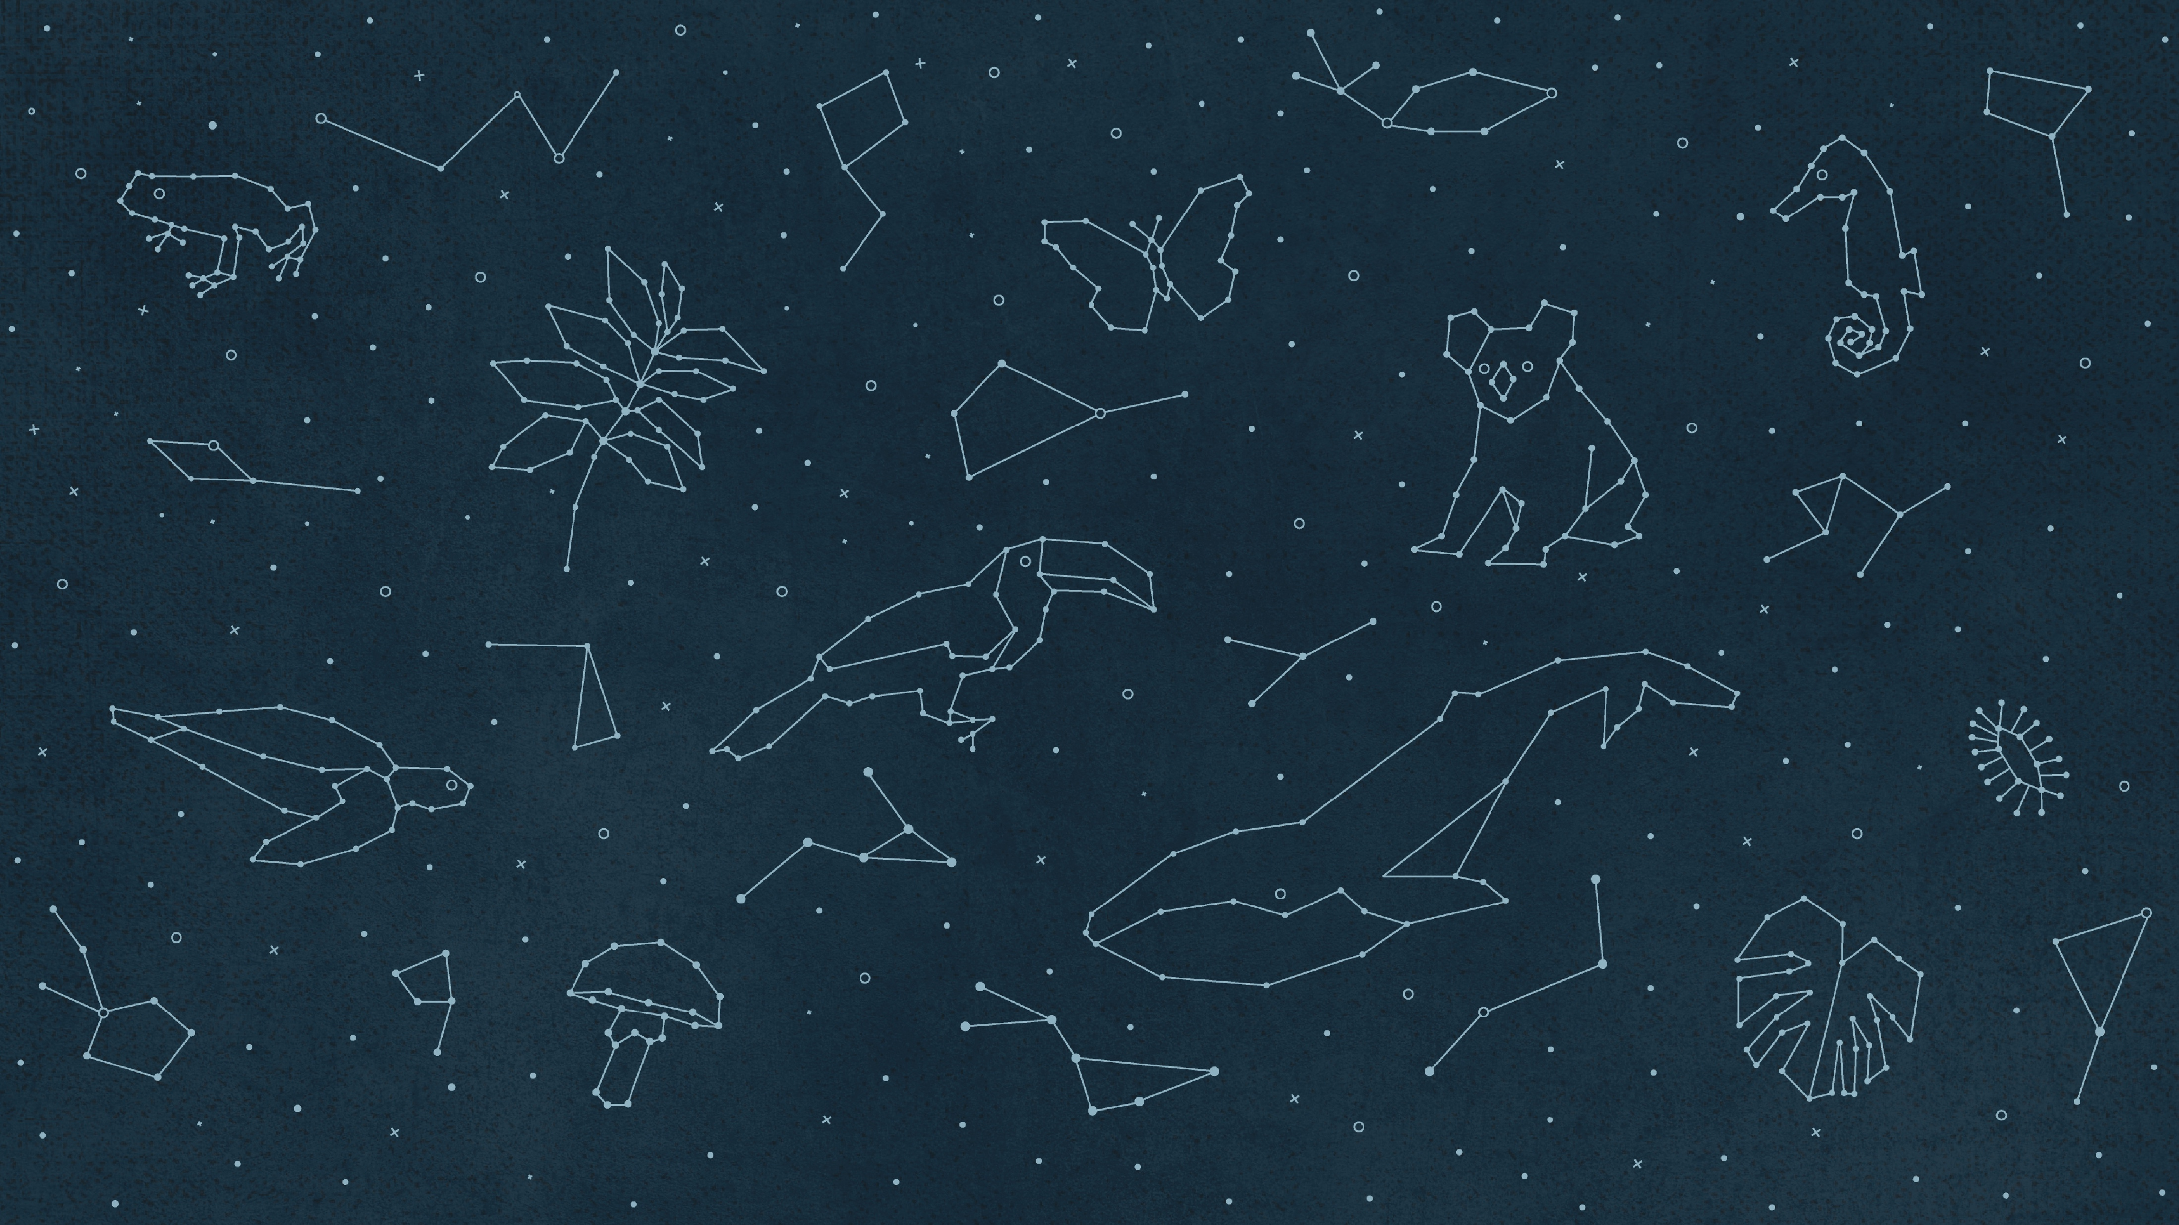

DNA
gbif.org/dna

Slide 2
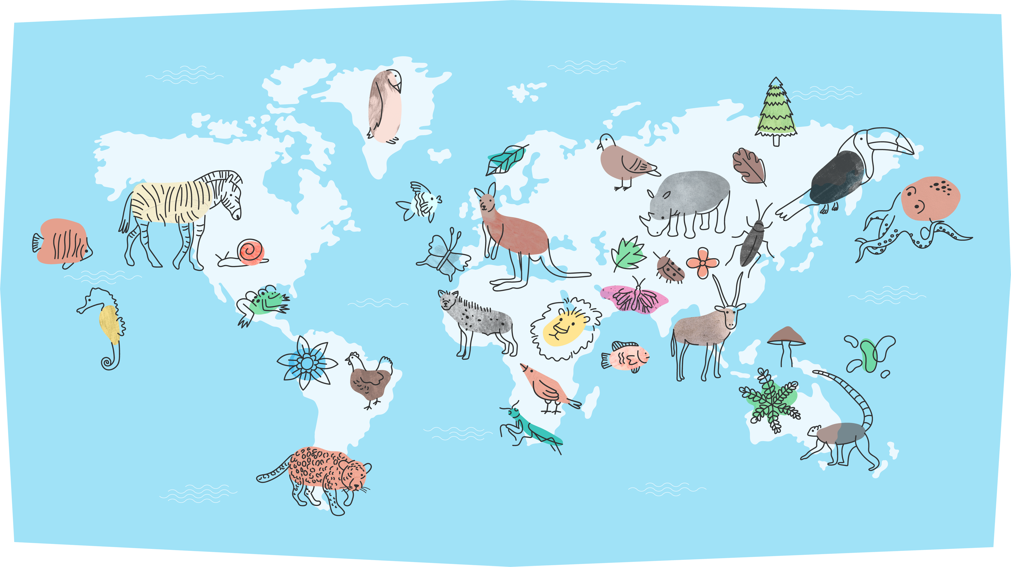
DNA
Notes:
Text from postcard: DNA-derived occurrences on GBIF reuse and extend metagenomic data on wild species, increasing FAIR and open data on biodiversity while offering a more complete and inclusive picture of life on Earth.

Slide 3
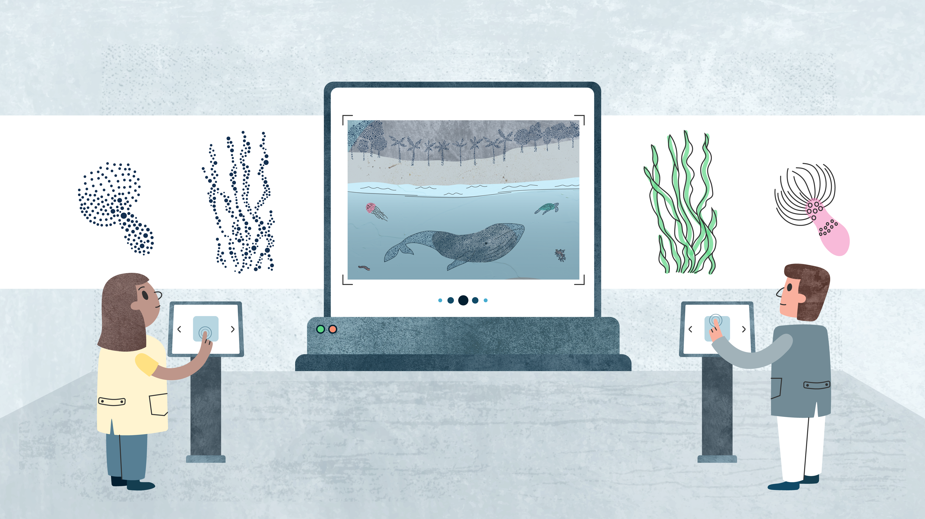
DNA
GBIF collaborates with experts and organizations to incorporate DNA-derived biodiversity data, resulting in a more comprehensive picture of life on Earth
Notes:
Notes

Slide 4
DNA
Advances in sequencing technologies, like DNA barcoding of specimens and metabarcoding of environmental DNA, have revolutionized how we detect, delimit, identify and quantify species and species assemblages. These methods allow scientists to detect organisms that traditional methods miss while accessing habitats that are otherwise difficult–or impossible–to survey.
Many DNA-based observations involve organisms that lack formal scientific names. Because they are not yet integrated into traditional taxonomic systems, these groups of “dark taxa” risk being overlooked in conservation, science and policymaking, despite their broad distribution, functional diversity and substantial biomass. However, molecular species catalogues enable GBIF to index these dark taxa alongside recognized species, ensuring that they surface in the global pool of biodiversity data.
By working with a widening circle of partners and collaborators, GBIF is expanding its collection of DNA-derived biodiversity data, from barcoded museum specimens to environmental DNA samples collected in the wild. By incorporating such DNA-derived data, GBIF helps bring dark taxa to light while advancing toward a more faithful digital representation of the planet’s biodiversity.

Slide 5
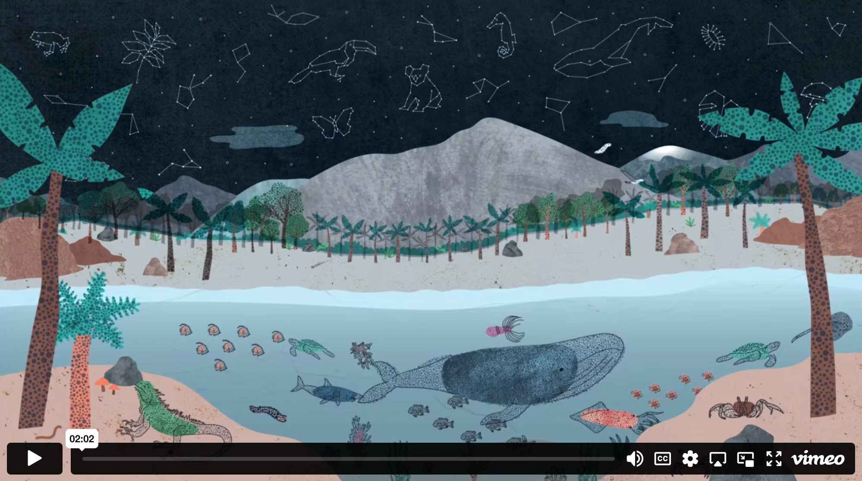
GBIF & conservation - Video

Slide 6
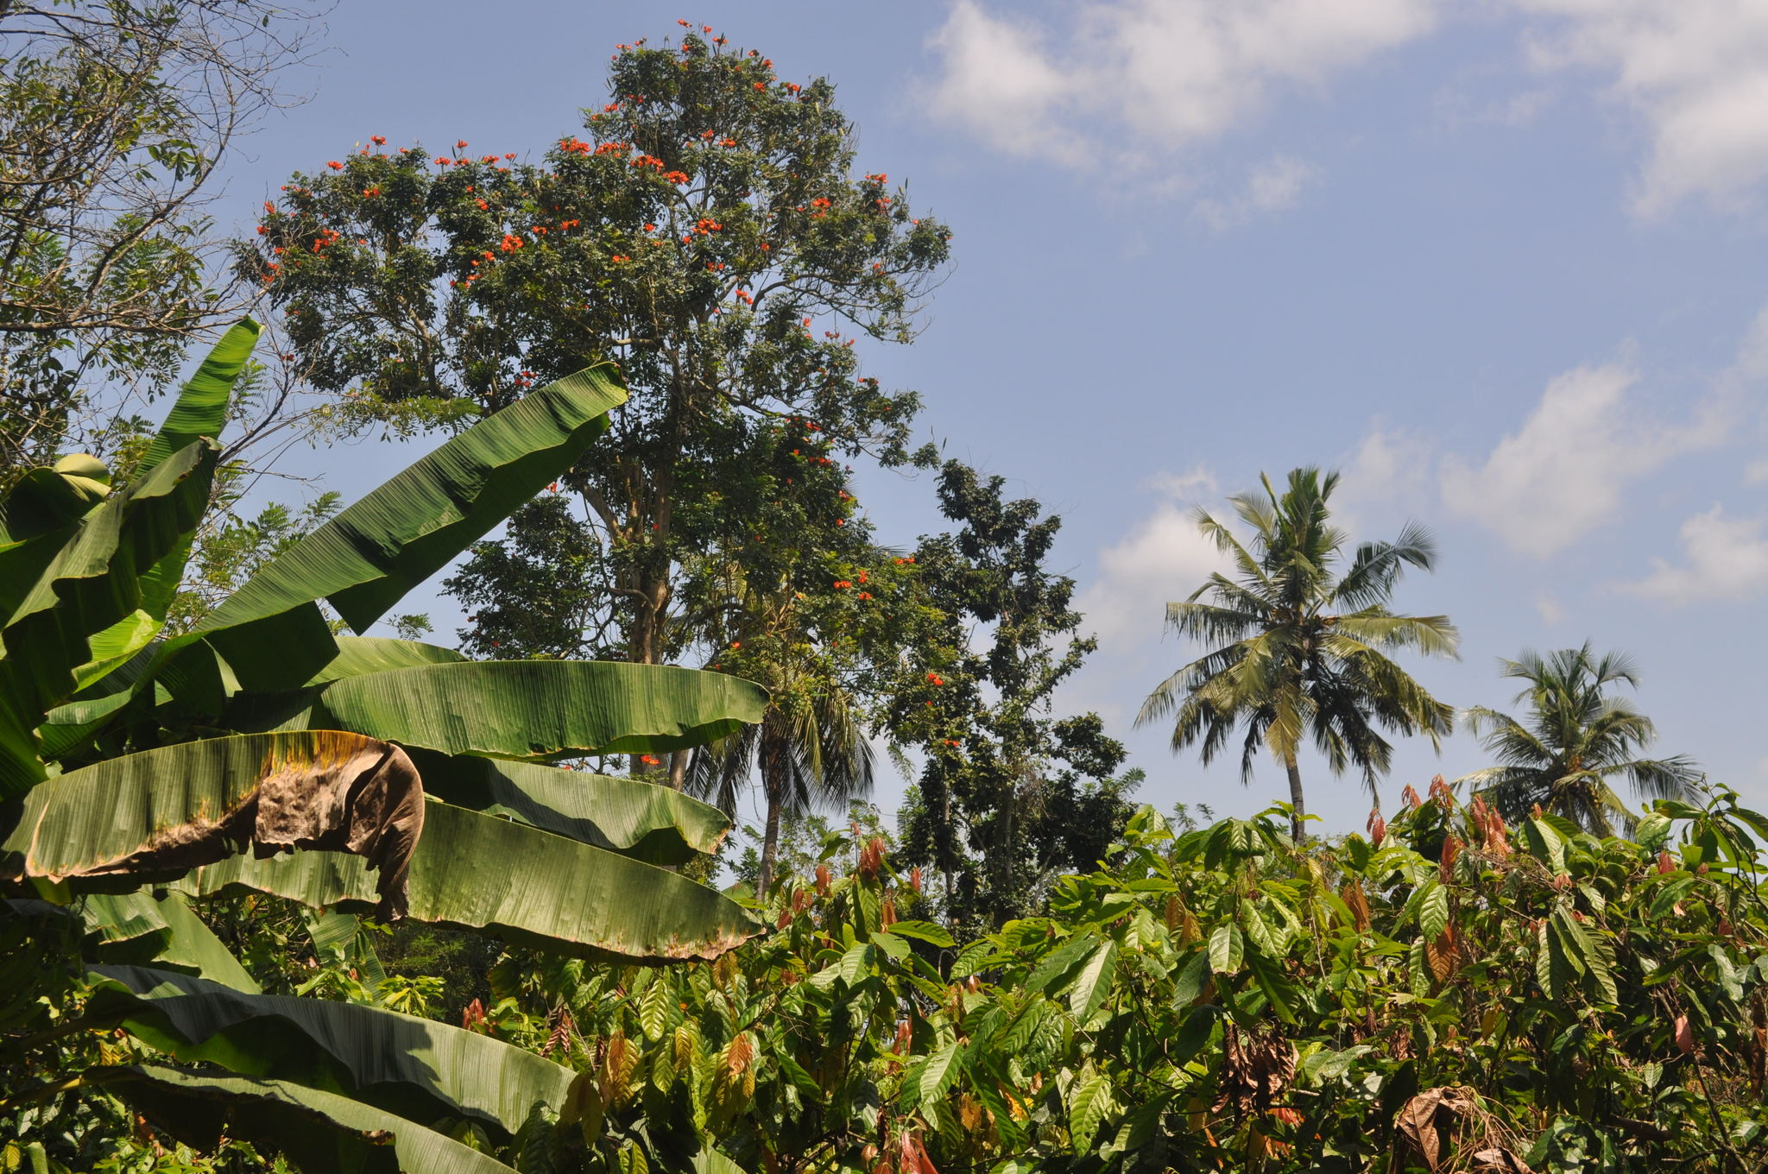
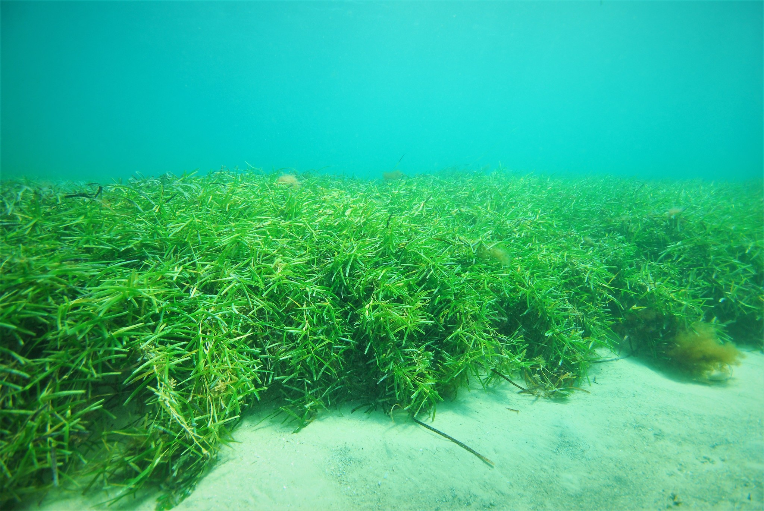
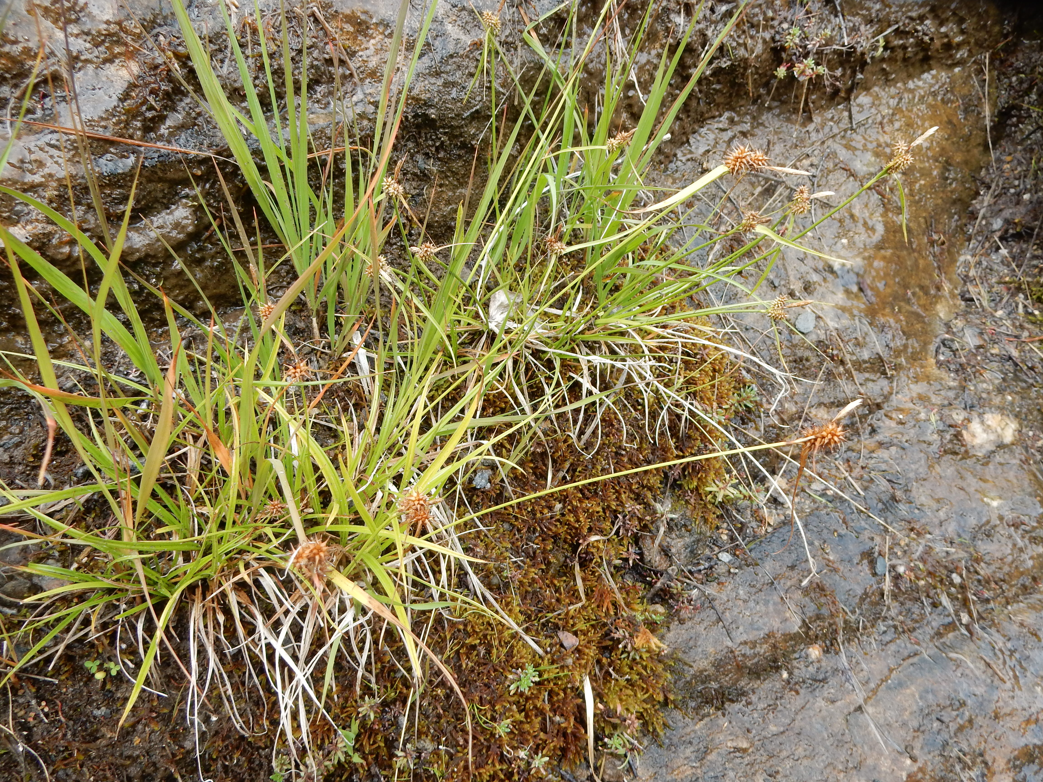
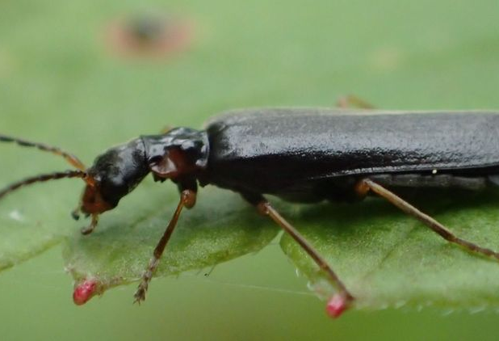
Featured data uses in DNA-related research
Synthesizing tree biodiversity data to understand global patterns of vegetation
Impediments to understanding seagrasses response to global change
Separating the sedges using population genomics and niche modelling
Rapid sampling to inform conservation in remote Alaskan wildlife refuges
Notes:
Notes

Slide 7
DNA
Learn more!

